Slide 1
Simon Game Icebreaker
Module C.1

Slide 2
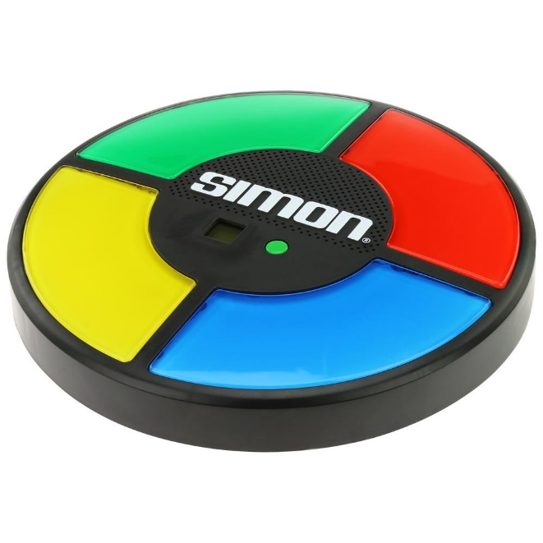
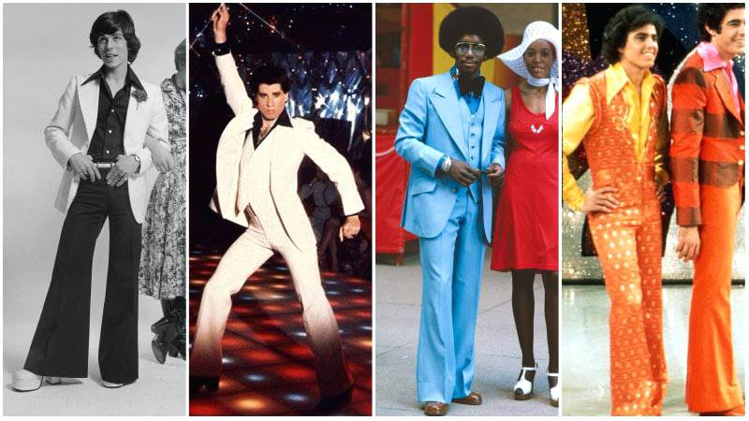
History Of Simon
Invented in 1978 by Ralph Baer (working for Milton Bradley / Hasbro Inc.)
Based on an earlier Atari Arcade game (1976)
Was completely new for its time (portable, flashy, easy to use)
Was quickly adopted and promoted by celebrities at the time (Studio 54)
Generated mainstreem public interest in computer games

Slide 3
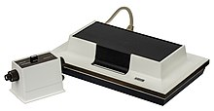
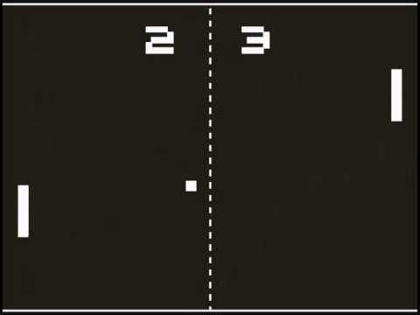
History Of Video Games
Ralph Baer is also known as the "Father of Video Games"
Began research into playing games on television screens (1966)
Developed the Magnavox Odyssey in 1972
The Odyssey was the first home game system
Used a TV display and gamepad controllers
Could load and run multiple games
Pong (aka TV Tennis) was one of the most popular games
Baer also invented the "light gun" for first person shooters

Slide 4

Your Turn
Get into 4 groups.
Share and explore your copy of the Simon game
Answer the Lesson Module Questions
Play the "Party" version of the game with ALL members of your group
Record your best group score
Make observations about the quality of the game play
Be prepared to share your results

Slide 5
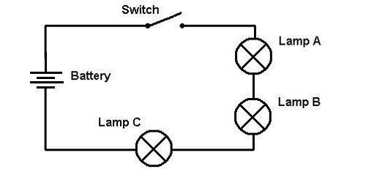

Simon vs. Light Switch

Slide 6
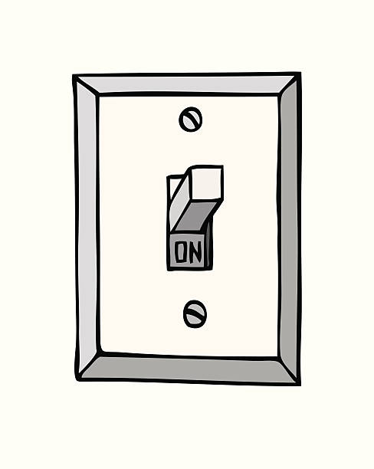
A Light Switch
Input Objects
Processes & Logic
Output Objects
What happens when you flip the light switch?
What different things could happen?

Slide 7
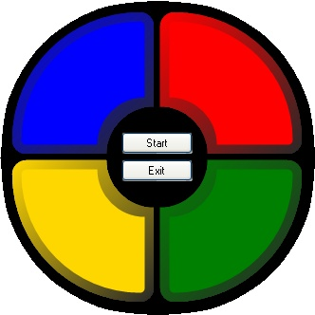
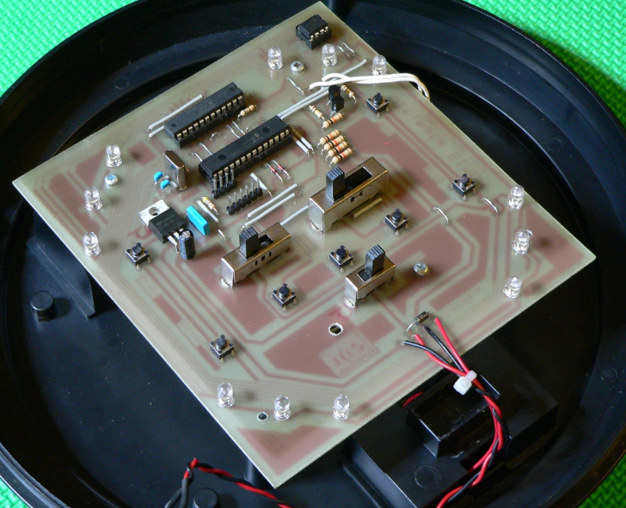
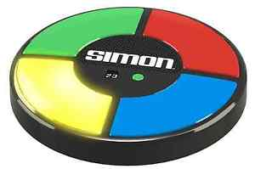
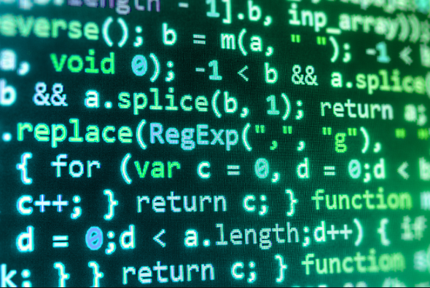
The Simon Game
Input Objects
Processes & Logic
Output Objects
Hardware
Software
What happens when you press the green button?
What different things could happen?

Slide 8
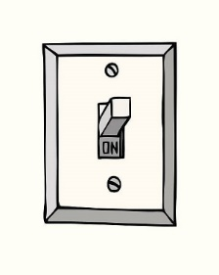

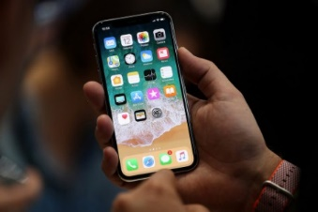
Light Switch – The Future Is Now
Input Objects
Eg. BELL Smart Home
Output Objects
Even basic household wiring will be connected to a controller / computer

Slide 9
Research Question
Keyword “Emulate”
To duplicate the function of programs designed for one computer so that they can run on another type of computer.
Examples:
Xbox Emulators can run Xbox games on home PCs
Android Emulators can run Android apps on an iPhone
Google Options:
“Simon Game Emulations”

